Slide 1
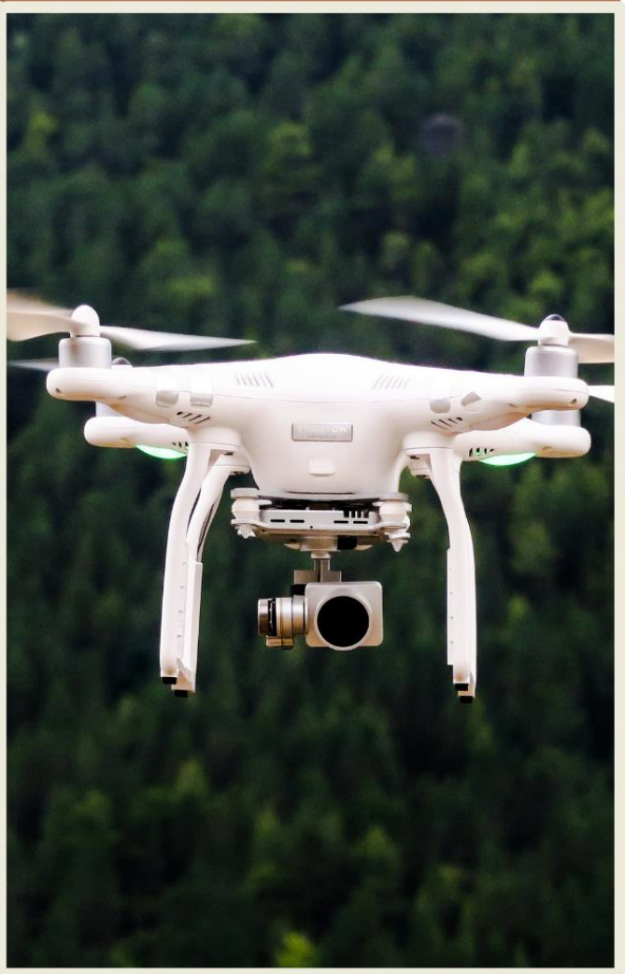
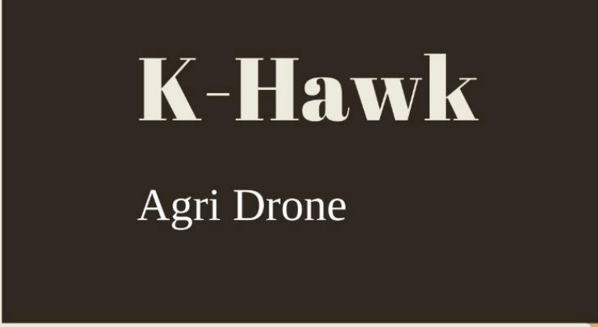

UNIVERSITY: K L UNIVERSITY

Slide 2
MODULES
Building a Drone according to our requirements
Building a interface between the drone and phone
Connecting the Drone’s memory to the cloud
Testing the Drone in every variables and conditions
Attaching the Thermal Sensor to our Drone according to our requirements

Slide 3
PROBLEM STATEMENT
In this century, humankind has made fantastic advancements in technology
pesticides and fertilizers play a critical role in controlling insects and increasing crop yields.
Spraying pesticides and fertilizers by hand causes tumors, hypersensitivity, allergies, and other illnesses in people.
The challenge is designing and developing a drone that can automate pest infestations, pesticide spraying, and field tracking with the help of deep learning and IoT technologies.
The usage of pesticides and fertilizers has increased a lot in the recent times
This is to increase the yield of the crops and remove the insects in the fields
There can an alternative to the increased usage of pesticides and fertilizers for the removal of insects from the fields
That is finding the position of the insects using thermal imaging and data visualization
That thermal sensor will be mounted on a drone for the top view of the fields
With the help of the drone, we can scan the whole field and pinpoint each exact location of the insects

Slide 4
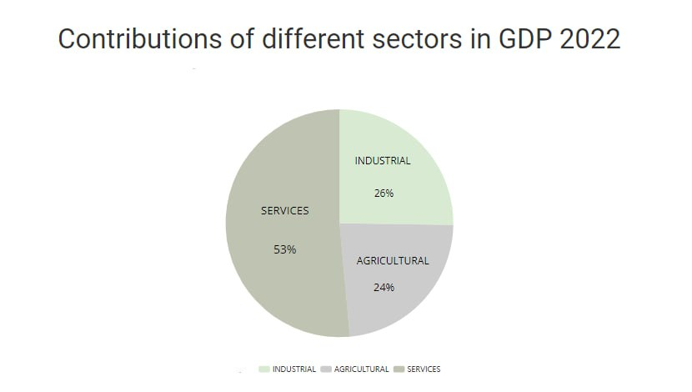
The market size of the farming sector in India is estimated to be around US$ 120 billion in 2021.
However, this figure is constantly changing and may vary based on various factors such as government policies, changes in consumer demand, technological advancements, and the overall state of the economy.
The agriculture sector plays a crucial role in the Indian economy and employs a large portion of the country's population.
Despite the significant contribution, the sector is still facing various challenges such as low productivity, lack of access to credit and markets, and outdated farming methods.
The Indian government has been taking various initiatives to modernize agriculture and provide farmers with better access to resources and markets.
There are several ways in which profits can be generated in the agriculture sector in India using drones:
Crop Monitoring: Drones equipped with thermal sensors can be used to monitor crops, identify stressors, and track growth patterns. This information can be used to optimize irrigation and fertilization, ultimately leading to improved crop yields and increased profits.
Precision Agriculture: Drones can be used for precise and efficient application of fertilizers and pesticides, reducing waste and improving crop health.
Livestock Monitoring: Drones equipped with cameras can be used to monitor livestock and detect any health problems early, allowing for prompt treatment and reducing the risk of disease outbreaks.
Soil Analysis: Drones equipped with sensors can be used to collect soil samples and perform aerial mapping, providing farmers with valuable information about soil quality and nutrient levels.
Disaster Response: In the event of natural disasters such as floods, droughts, or wildfires, drones can be used to quickly survey affected areas and assess the damage. This information can be used to make informed decisions about crop recovery efforts.
MARKET SIZE

Slide 5
Drones equipped with thermal sensors are increasingly being used in agriculture to monitor crop pest infestations.
Drone technology, including autonomous flight and GPS-based navigation, allows for efficient and cost-effective crop monitoring.
By using thermal sensors, the drone can collect temperature data, even in hard-to-reach areas, and provide radiometric data analysis.
The implementation of drone-based remote sensing technology in agriculture has the potential to save time and resources compared to traditional field inspection methods.
In this approach, an acre of land is divided into four sections, which are scanned by drones with thermal sensors. The data collected from each section is analyzed to determine the percentage of arthropod pests, with the section having the highest pest infestation rate being identified.
Finally, the data is recorded and used to determine the required pest control measures for each division.
Using the Data visualization process we can pinpoint the % of arthropod pests in each sector of the fields
We can even recommend pesticides for the farmer s
We can also determine the exact number of pesticides required for the farmer for his field
Proposed Methodology

Slide 6
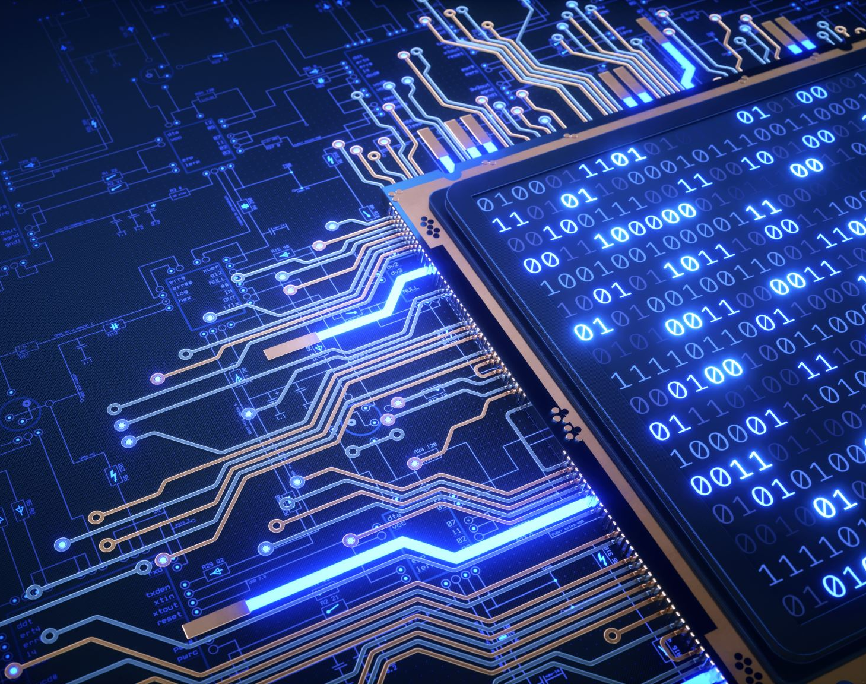
The technology that could be used in this project includes:
Hardware:
Drone equipped with heat sensor.
Remote control device to operate the drone.
Software:
Algorithm to compare primary and secondary images and identify the insects
Data visualizations
Heat sensing software to ensure organic variables are not affected.
Data analysis software for collected data
User interface for the users

Slide 7
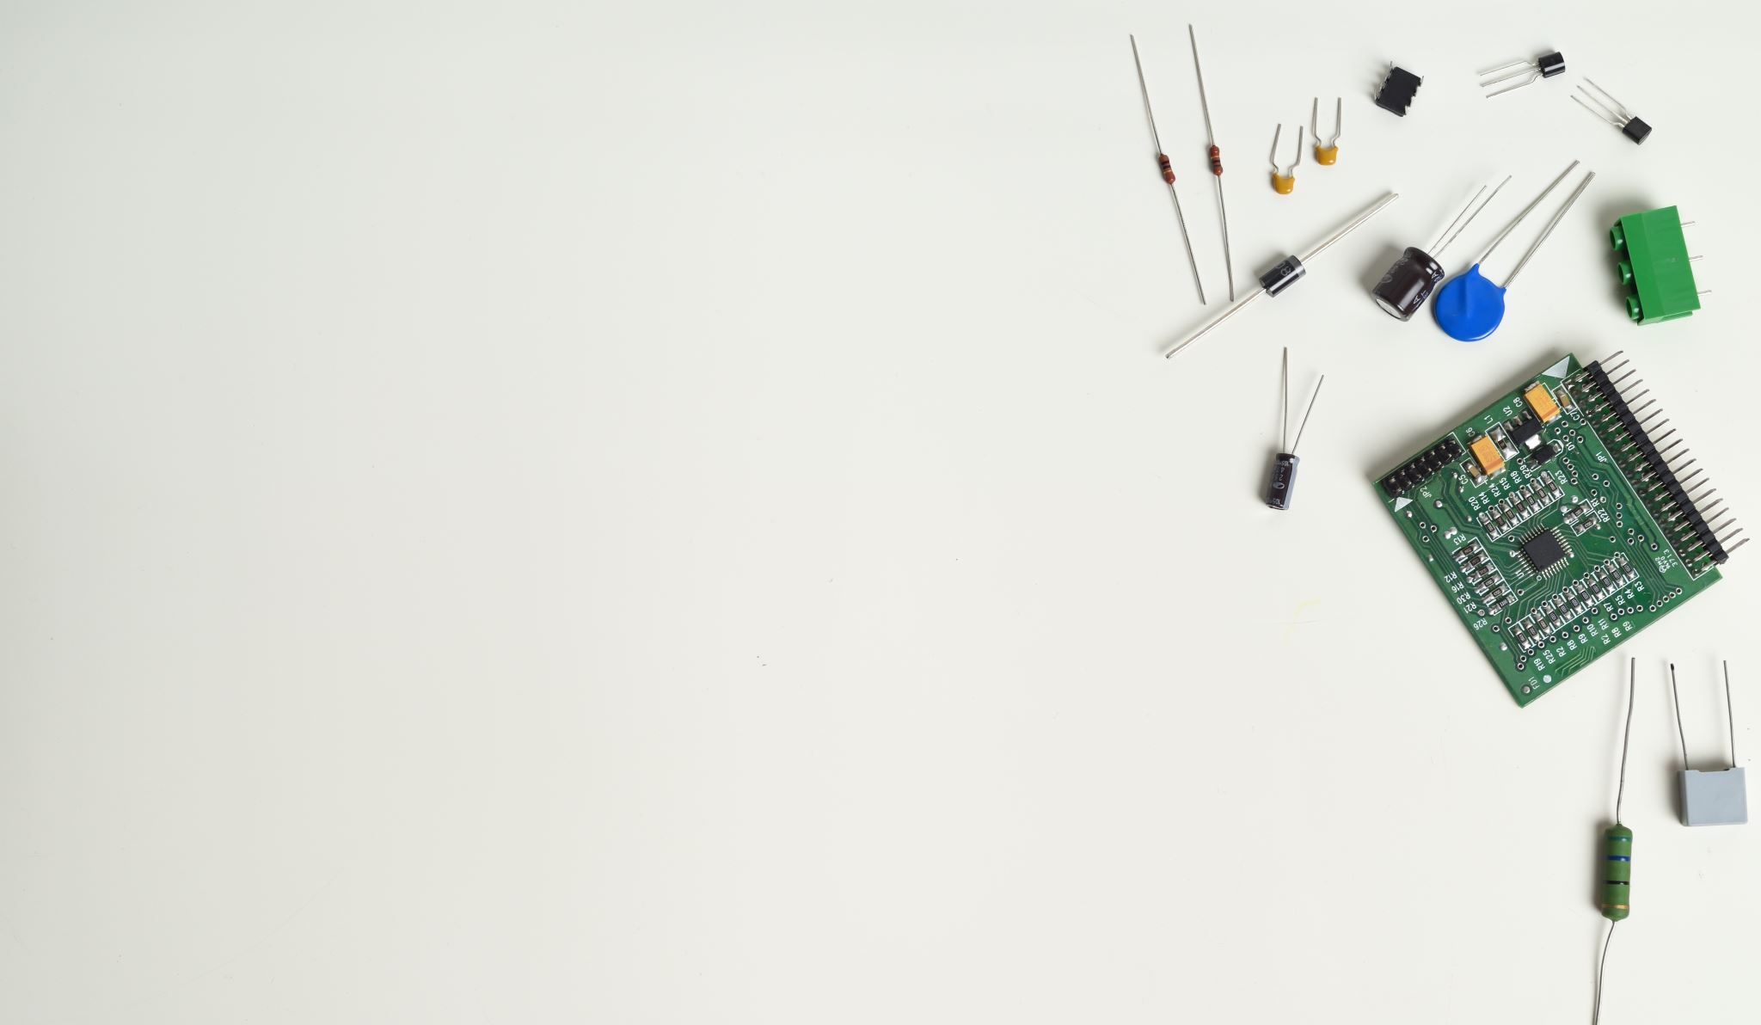
LOGISTICS :
As I have mentioned earlier, we will hire a qualified student from each village
We will provide them with a working space and then it can act as the serving center also
We will provide training to the executive on common basic problems in the drones
If the executive is unable to solve it then the main center will dispatch the senior executive to the village
There he can repair the drone in the workspace provided by the company to the executive

Slide 8
MARKETING
Local Workshops and Demonstrations: Conduct local workshops and demonstrations to show farmers the benefits of using drones in agriculture. Demonstrate how drones can be used to monitor crops, detect pest infestations, and increase crop yields.
Partner with Local Organizations: Partner with local organizations that work with farmers, such as agricultural co-operatives, to spread awareness about the benefits of using drones in agriculture.
Online Marketing: Use online platforms such as social media, websites, and online forums to reach a wider audience and create awareness about the benefits of using drones in agriculture.
Outreach Programs: Conduct outreach programs to educate farmers about the benefits of using drones in agriculture. Collaborate with government agencies to organize these programs.
Industry Conferences and Trade Shows: Attend industry conferences and trade shows to network with industry leaders, farmers, and other stakeholders. Showcase the benefits of using drones in agriculture and how they can help improve crop yields and reduce costs.
Collaborate with Agricultural Institutions: Collaborate with agricultural institutions to conduct research and develop solutions that can help farmers maximize the benefits of using drones in agriculture.

Slide 9
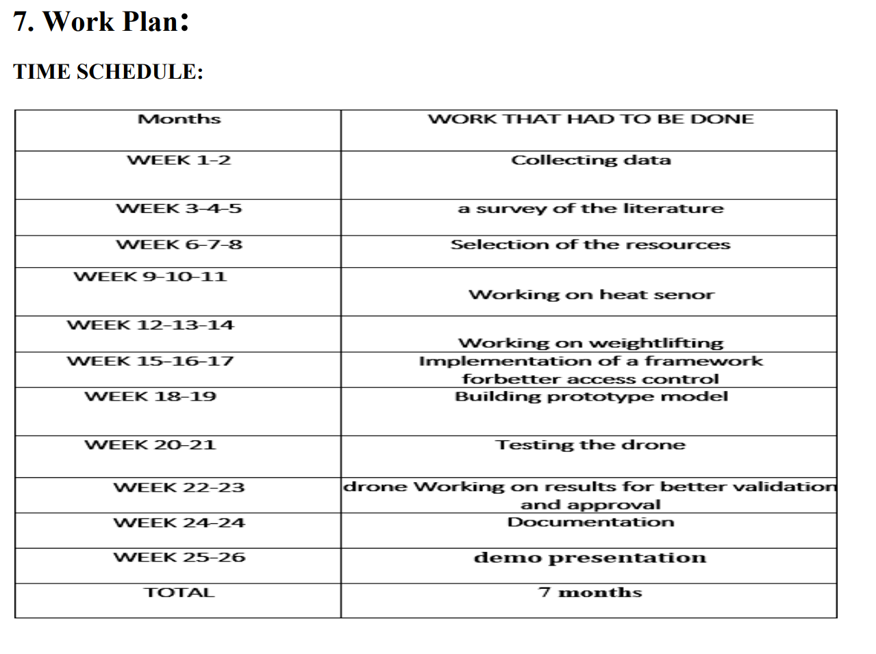

Slide 10
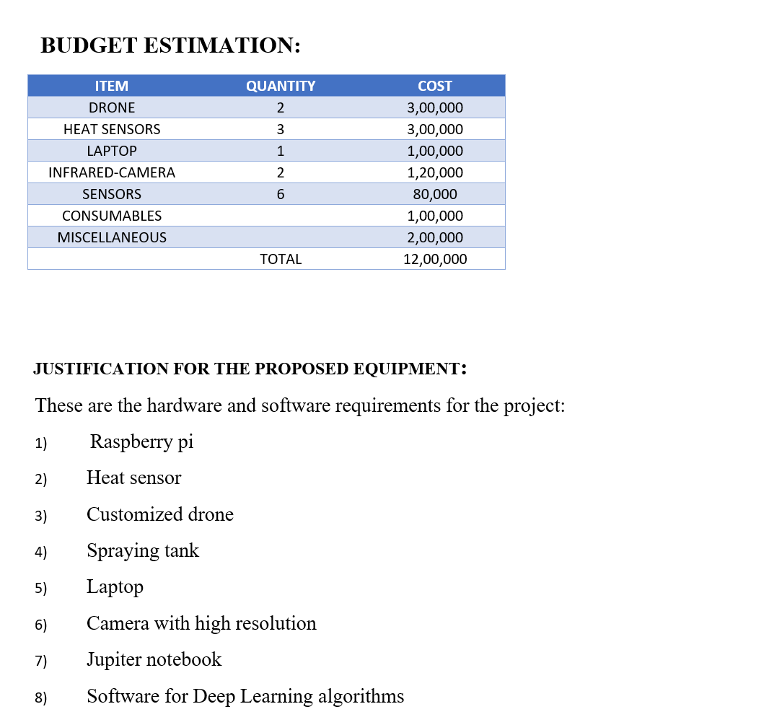

Slide 11
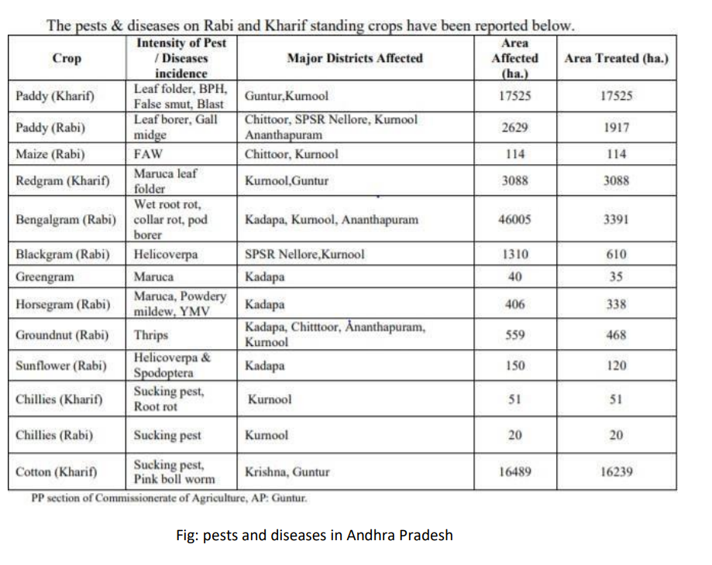
DATA BASE
We will create a database in that database we have details of every iinsectthat affect the region we are planning on introducing our drone
When we get the Images uploaded by the executive, we can identify the insects using the database

Slide 12
REVENUE:
We will be having three streams of revenue in our project they are :
1)Active: we will generate revenue by directly selling the product to the distributor, and we will just provide servicing that too for money.
2)Passive: we will lease our product to the executive and train him, we will help him set up a small workspace and in return, he will pay us back
3)Subscription: both the distributor and executive have to use the user interface that we will develop, in order to use them they must pay a yearly fee
- If there is a loss in one of the revenue streams, the other streams will recover it

Slide 13
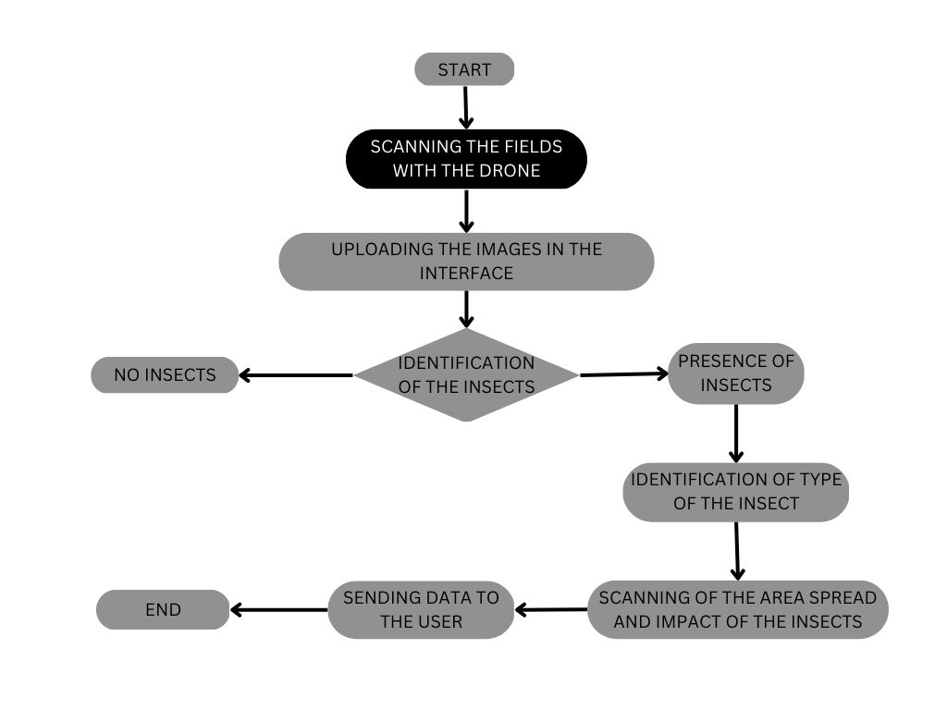

Slide 14
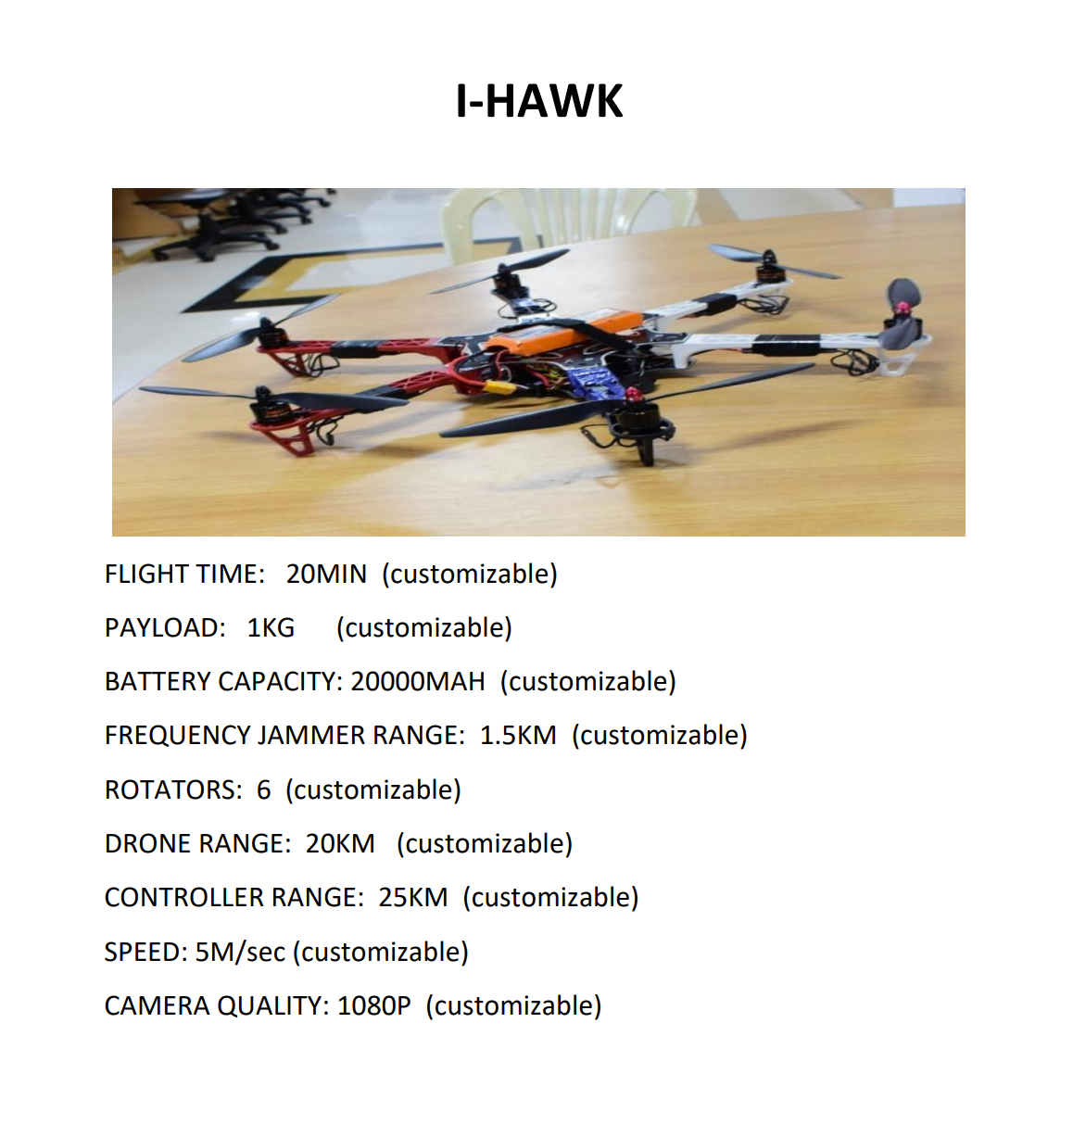
Video and Camera Shots from Drone :
https://mega.nz/folder/xdoggQ4I#K0PDarCZ7jEU-rdJdPv21g

Slide 15
Thank you

